Slide 1
Session 28
Pre-training & Fine-Tuning
How a raw next-token predictor becomes a helpful assistant — and how to adapt one on a single GPU
Causal LM · Masked LM · Instruction Tuning · RLHF · LoRA · QLoRA · PEFT
Computer Vision & AI · One-on-One Series

Slide 2
Today's Roadmap
≈ 1.5 hours · theory first, then a full QLoRA fine-tune on a free GPU
The three lives of an LLM
5 min
Why full fine-tuning breaks
5 min
1
6
Pre-training — Causal LM
10 min
LoRA — low-rank adaptation
10 min
2
7
Pre-training — Masked LM
8 min
QLoRA & the PEFT family
10 min
3
8
Instruction Tuning (SFT)
10 min
Hands-on Lab — QLoRA fine-tune
25 min
4
9
RLHF & DPO — alignment
10 min
5

Slide 3
The Three Lives of an LLM
Every model you use — GPT, Claude, LLaMA — went through these stages in order
1
2
3
PRE-TRAINING
INSTRUCTION TUNING
ALIGNMENT
Learn language itself
Learn to be useful
Learn to be preferred
Trillions of tokens of raw text
10K–1M instruction/response pairs
Human preference comparisons
No human labels at all
Human-written demonstrations
Which of these two is better?
Objective: predict tokens
Objective: supervised next-token
Objective: reward / preference
Weeks to months · $10M+
Hours to days · cheap
Days · moderate cost
Output: a base model
Output: an instruct model
Output: a chat model
Today we cover all three — plus the trick that lets you do stages 2 and 3 yourself on one consumer GPU.

Slide 4
What Pre-training Actually Is
Self-supervised learning: the data labels itself
The core trick
The scale involved
You never need a human to label anything.
The text itself is both the input and the answer — hide part of it, ask the model to reconstruct it, compare against what was really there.
Training tokens
~1–15 trillion
Parameters
1B – 500B+
GPU time
10⁴ – 10⁶ GPU-hours
That single idea is what let us scale to the entire internet.
Cost
$1M – $100M+
Two ways to hide text — and they produce very different models
CAUSAL LM
MASKED LM
Hide the future.
Hide the middle.
Predict the next token from the left context only.
Predict blanked-out tokens using both sides.
GPT · LLaMA · Mistral · Claude
BERT · RoBERTa · DeBERTa
Both are pre-training. The choice of what you hide decides what the model is good at for the rest of its life.

Slide 5
Causal Language Modelling
Predict the next token — the objective behind every model that generates text
ONE TRAINING EXAMPLE
The
cat
sat
on
the
mat
Loss on every position.
A 6-token sentence gives 6 training signals, not 1.
◄────── context (visible) ──────►
◄── must predict ──►
1
Only sees the left
THE OBJECTIVE
A causal mask blocks attention to future tokens, so position i can never peek at i+1. This is what makes generation possible.
maximise Σ log P(xᵢ | x₁ … xᵢ₋₁)
2
Trains and generates the same way
Because the objective is 'continue the text', the trained model can be run autoregressively — feed its own output back in.
In plain words:
"Given everything so far, make the token that actually came next as likely as possible."
3
Learns far more than grammar
GPT · LLaMA · Mistral · Gemma · Qwen
To predict the next token well over trillions of tokens, the model is forced to absorb facts, reasoning patterns, style and code.
Every model in the lab today is a causal LM. Instruction tuning and RLHF do not change this objective — they only change the data.

Slide 6
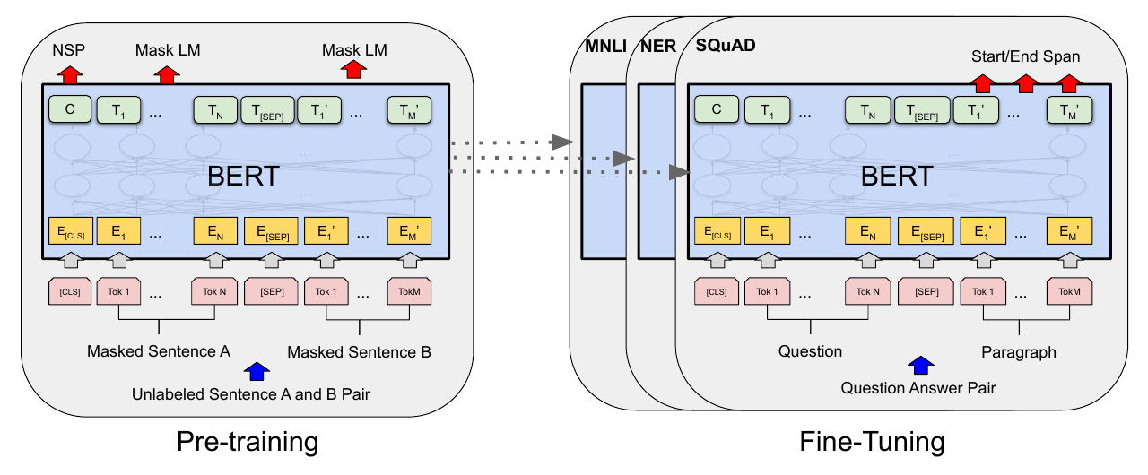
Masked Language Modelling
Predict the blanks — the objective behind encoders like BERT
MASK ~15% OF TOKENS AT RANDOM
THE OBJECTIVE
The
[MASK]
sat
on
[MASK]
mat
maximise Σ log P(xᵢ | x∖masked)
The model sees the whole sentence — left AND right — when filling each blank.
Loss only on the masked positions — roughly 15% of tokens, so it is less sample-efficient per pass.
The original figure from the BERT paper — one pre-trained model, then fine-tuned per task
Devlin et al., 2019 — BERT, Figure 1 (arXiv:1810.04805). Left: pre-training with Masked LM + Next Sentence Prediction. Right: the same weights fine-tuned for MNLI, NER and SQuAD.

Slide 7
Causal vs Masked — Choosing the Right Objective
They are not competing versions of the same thing; they solve different problems
CAUSAL LM (decoder)
MASKED LM (encoder)
Sees
Left context only
Both directions
Trained to
Continue the text
Fill in the blanks
Loss on
Every token (100%)
Masked tokens (~15%)
Natural output
Free-form generation
A rich representation
Good at
Chat, code, summarisation, reasoning, anything generative
Classification, NER, retrieval, sentence embeddings
Cannot easily
Be a strong bidirectional encoder
Generate fluent long text
Examples
GPT · LLaMA · Mistral · Gemma
BERT · RoBERTa · DeBERTa · E5
Everything else today — instruction tuning, RLHF, LoRA, QLoRA — is applied to causal models, because that is what we want to talk to.

Slide 8
A Base Model Is Not an Assistant
Pre-training gives you knowledge. It does not give you obedience.
BASE MODEL · after pre-training only
INSTRUCT MODEL · after SFT
Prompt
Same prompt
"List three uses of solar power."
"List three uses of solar power."
Likely continuation
Response
"List three uses of wind power. List three uses of geothermal power. List three disadvantages of…"
"1. Generating electricity via PV panels 2. Heating water for domestic use 3. Powering off-grid equipment"
It continued the pattern. It never answered.
Same knowledge — now in the right shape.
Why this happens
The training data
The objective
The internet is full of documents that list, continue and repeat. It is not full of polite, complete answers to direct commands.
'Predict the next token' rewards plausibility, not helpfulness. Nothing in pre-training ever told the model that answering is preferred.

Slide 9
Instruction Tuning (SFT)
Supervised fine-tuning on demonstrations of the behaviour you want
ONE TRAINING RECORD · databricks-dolly-15k
WHAT THE MODEL ACTUALLY SEES
instruction
<|user|>
"When did Virgin Australia start operating?"
When did Virgin Australia start
context
operating?</s>
"Virgin Australia … commenced services on 31 August 2000 …"
response
<|assistant|>
"Virgin Australia commenced services on 31 August 2000"
Virgin Australia commenced
category
services on 31 August 2000</s>
"closed_qa"
15,011 records, hand-written by Databricks employees.
loss is computed on the green tokens only
Same objective, new data
Masking the prompt matters
Still next-token prediction. Nothing about the maths changed — only what we feed it.
We zero the loss on the instruction so the model learns to answer, not to reproduce questions.
Quality ≫ quantity
This is what you'll run today
QLoRA's authors found a curated 9K-sample set beat a 450K-sample one. Curate, don't scrape.
The lab is exactly this — Dolly-15k, chat template, prompt masked, on TinyLlama.

Slide 10
Why Go Beyond SFT?
Some things are easy to judge and very hard to demonstrate
SFT teaches the model to imitate
The key insight
It copies the average of your demonstrations. If your labellers write mediocre answers, you get a mediocre model.
Humans are much better critics than authors.
RLHF turns that asymmetry into a training signal.
Writing a perfect answer is hard
Ask a labeller to write the ideal response to 'explain quantum tunnelling to a child'. Slow, expensive, inconsistent.
It also unlocks things SFT cannot express:
• be honest about uncertainty
• refuse harmful requests
• stay concise unless asked otherwise
Comparing two answers is easy
Show the same labeller two responses and ask 'which is better?'. Fast, cheap, far more consistent between people.
Alignment is where 'a model that knows things' becomes 'a model you would actually ship to users'.

Slide 11
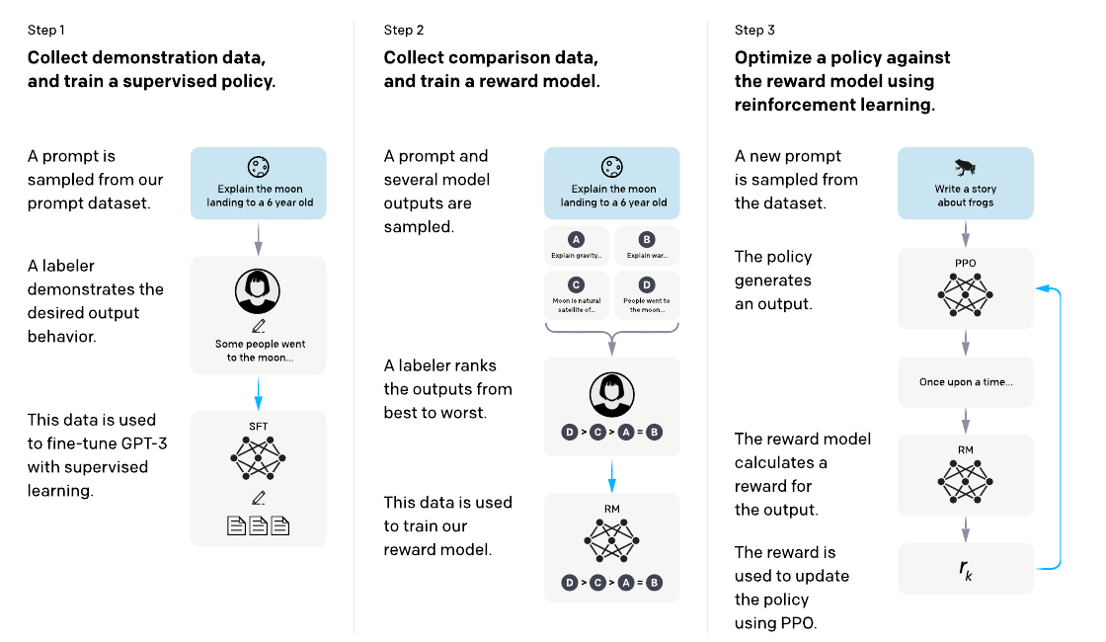
RLHF — The Three-Step Pipeline
Reinforcement Learning from Human Feedback, as introduced by InstructGPT
1
SFT
Collect human demonstrations and fine-tune with supervised learning. This is exactly the instruction tuning we just covered.
2
Reward Model
Sample several outputs per prompt, have labellers rank them, then train a model that scores any response with a single number.
3
PPO
Generate → score with the reward model → update the policy. A KL penalty keeps it from drifting away from the SFT model.
Ouyang et al., 2022 — InstructGPT, Figure 2 (arXiv:2203.02155). Blue arrows mark data used to train a model.

Slide 12
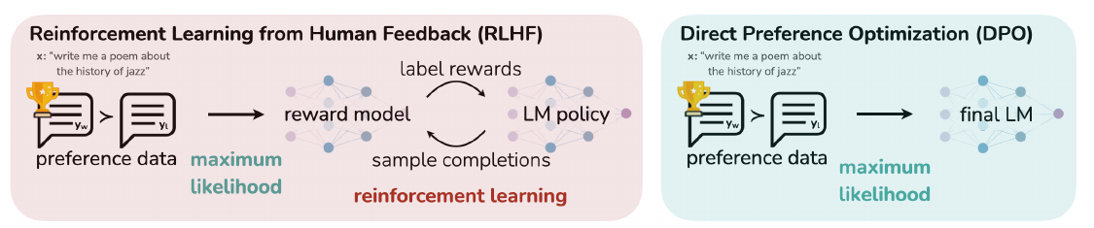
DPO — Skipping the Reward Model
Direct Preference Optimization: the same goal, without reinforcement learning
Rafailov et al., 2023 — DPO, Figure 1 (arXiv:2305.18290). Left: classic RLHF. Right: DPO collapses the loop into one supervised-style step.
RLHF / PPO
DPO
Trains a separate reward model
No reward model at all
Samples from the policy during training
No sampling — the dataset is fixed
Three models in memory at once
Two models (policy + frozen reference)
Sensitive to hyperparameters, can be unstable
A simple classification-style loss
Still used at the frontier labs
The default for open-source alignment

Slide 13
Part 1 Recap — The Full Training Pipeline
Four stages, four kinds of data, four objectives
STAGE
DATA
OBJECTIVE
WHAT YOU GET
Pre-training (Causal LM)
Trillions of raw web tokens
Predict the next token
A base model that knows a lot
Pre-training (Masked LM)
Same corpora, tokens masked
Predict masked tokens
An encoder for understanding
Instruction tuning (SFT)
Instruction → response pairs
Next token, loss on the answer
A model that follows orders
Alignment (RLHF / DPO)
Human preference comparisons
Maximise preference, stay near SFT
A model people prefer
Stages 3 and 4 are where you come in — and where the cost problem starts. That is Part 2.

Slide 14
Part 2
Efficient Fine-Tuning
Everything so far assumed you can afford to update every weight in the model. For a 7B model on a consumer GPU, you cannot. Here is how we get around that.

Slide 15
Why Full Fine-Tuning Breaks Down
The memory bill for updating every parameter of a 7B model in mixed precision
Memory breakdown · 7B parameters
What that actually means
Weights
fp16
14 GB
A free Colab T4 has 16 GB. An A100 has 80 GB.
Gradients
fp16
14 GB
So a 7B full fine-tune needs multiple datacentre GPUs.
Every task you fine-tune for produces another full 14 GB checkpoint.
Adam state m
fp32
28 GB
Ten tasks = 140 GB of near-identical weights to store and serve.
Adam state v
fp32
28 GB
The observation that saves us
Activations
varies
5–20 GB
Fine-tuning barely moves the weights.
The update ΔW needed to specialise a pre-trained model has very low intrinsic rank — it lives in a tiny subspace.
So why store and train it as a full d×d matrix?
TOTAL
≈ 90–110 GB

Slide 16
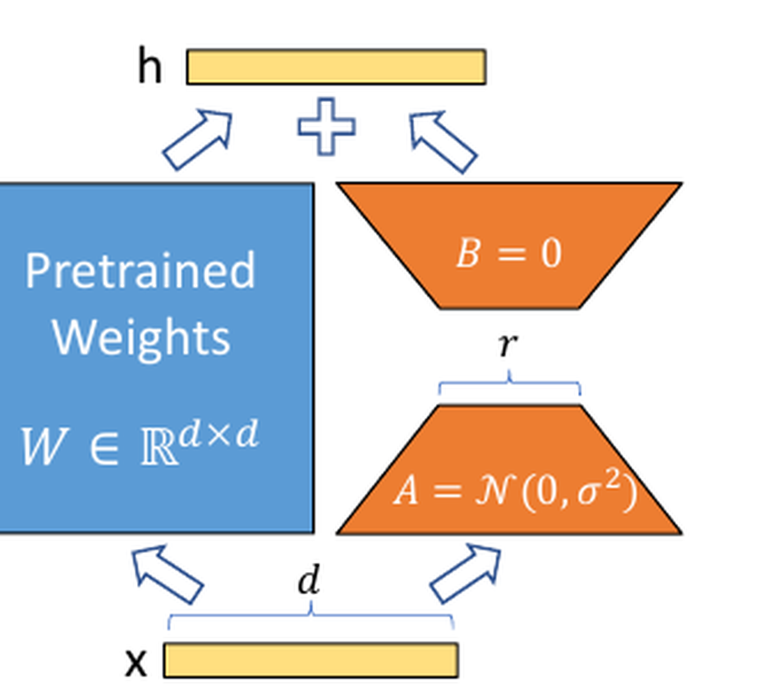
LoRA — Low-Rank Adaptation
Freeze the pre-trained weights; learn a small low-rank update beside them
THE WHOLE IDEA IN ONE LINE
h = W₀x + ΔWx → h = W₀x + BAx
W₀ frozen (blue) · A, B trained (orange) · A is r×d, B is d×r, with r ≪ d
Why it works
The adaptation ΔW is intrinsically low-rank, so BA with r as small as 8 captures nearly all of it.
B starts at zero
At step 0, BA = 0, so the model is exactly the pre-trained one. Training starts from a safe place.
10,000× fewer trainable params
Hu et al., 2021 — LoRA, Figure 1 (arXiv:2106.09685).
LoRA on GPT-3 175B trains ~0.01% of the weights and cuts optimiser memory ~3×.
Zero inference latency
After training you can fold BA into W₀. The deployed model is the same shape and speed as the original.

Slide 17
LoRA in Practice — The Four Knobs
These are the only hyperparameters you will actually touch today
r
How much capacity the adapter has. Higher r = more expressive, more memory. 8–16 is plenty for style and format; 32–64 for teaching genuinely new skills.
rank
8 – 64
lora_alpha
The update is scaled by alpha / r. A common default is alpha = 2r. Raising alpha makes the adapter's influence stronger.
scaling
16 – 32
lora_dropout
Dropout applied to the adapter input. Use 0.05–0.1 on small datasets to avoid memorising; 0 on large ones.
regularisation
0.0 – 0.1
target_modules
Which layers get adapters. The original paper used attention only; QLoRA showed adapting every linear layer closes the gap to full fine-tuning.
placement
q,k,v,o + MLP
Rule of thumb: start at r=16, alpha=32, dropout=0.05, all linear layers — then only change r if the model underfits.

Slide 18
A Quick Detour — Quantization
Storing the same weight in fewer bits, so the frozen model gets smaller
The same 7B model, four ways
FP32
32 bits
28 GB
Full precision. What you train in, classically.
FP16 / BF16
16 bits
14 GB
The standard for inference and mixed-precision training. Essentially lossless.
INT8
8 bits
7 GB
Integer quantization. Small quality cost; breaks down during training.
NF4
4 bits
3.5 GB
QLoRA's 4-bit NormalFloat. Information-theoretically optimal for normally-distributed weights.
Key point: quantization alone only helps inference — gradients through naively quantized weights are unstable. QLoRA is what makes it work for training.

Slide 19
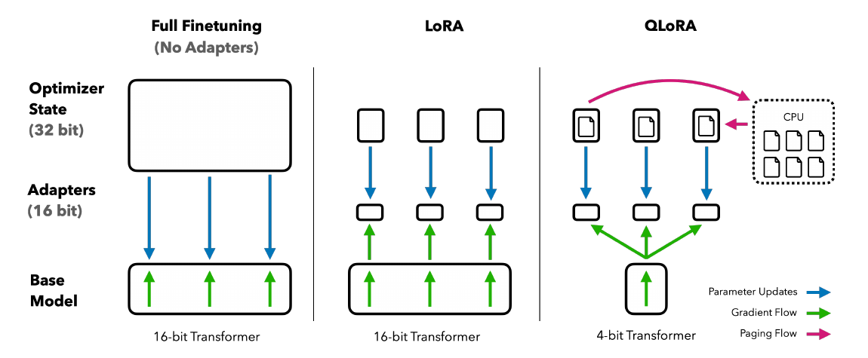
QLoRA — LoRA on a 4-bit Frozen Model
Quantize the base model to 4-bit, keep the adapters in 16-bit, train only the adapters
Dettmers et al., 2023 — QLoRA, Figure 1 (arXiv:2305.14314). Blue = parameter updates, green = gradient flow, pink = paging to CPU. Note that gradients flow straight through the frozen 4-bit transformer into the 16-bit adapters — the base model is never updated.

Slide 20
The Three Things QLoRA Added
Quantizing a model for inference is easy; making it trainable is not
1
2
3
4-bit NormalFloat (NF4)
Double Quantization
Paged Optimizers
THE PROBLEM
THE PROBLEM
THE PROBLEM
Standard 4-bit integer quantization wastes bins, because neural network weights are not uniformly distributed — they are close to a zero-centred normal.
Block-wise quantization needs one 32-bit scaling constant per block of 64 weights. Those constants are themselves a real memory cost.
Gradient checkpointing produces sharp memory spikes when a batch contains a long sequence. One spike and the whole run dies with an OOM.
THE FIX
THE FIX
THE FIX
Build the quantization bins from the quantiles of a normal distribution, so each bin holds an equal expected number of weights. Information-theoretically optimal for this data, and it beats INT4 and FP4 empirically.
Quantize the quantization constants too. Saves about 0.37 bits per parameter — roughly 3 GB on a 65B model, for free.
Use NVIDIA unified memory to page optimizer state out to CPU RAM during a spike and bring it back after — the same idea as OS virtual memory.
Result: a 65B model fine-tuned on ONE 48 GB GPU, matching 16-bit full fine-tuning quality. A 1–7B model now fits comfortably on a free Colab T4.

Slide 21
What QLoRA Bought Us
The numbers that made fine-tuning a hobbyist activity
780 GB
→
< 48 GB
100%
→
~0.2%
14 GB
→
~30 MB
Memory to fine-tune a 65B model
Share of parameters actually trained
Size of what you ship per task
Guanaco — the model they trained with it
The honest caveats
Guanaco 65B
41 GB
1022 Elo
QLoRA is slower per step than plain LoRA — you pay compute to save memory (roughly 20–40% slower).
Guanaco 33B
21 GB
992 Elo
Vicuna 13B
26 GB
974 Elo
4-bit quantization is not free; on very hard reasoning tasks a small gap to 16-bit can appear.
ChatGPT
—
966 Elo
LoRA adapts, it does not teach. Injecting large amounts of genuinely new knowledge still favours full fine-tuning or RAG.
Guanaco 13B
10 GB
916 Elo
QLoRA, Table 1 — Elo from GPT-4-judged pairwise matches on the Vicuna benchmark.
Benchmarks like Vicuna Elo are noisy — the paper itself says so.

Slide 22
PEFT — The Wider Family
Parameter-Efficient Fine-Tuning is the category; LoRA is just its most successful member
LoRA
QLoRA
Low-rank matrices beside frozen weights.
LoRA + a 4-bit quantized base model.
The default. Start here.
When memory is the binding constraint.
Prefix / P-Tuning
Adapters (Houlsby)
Learn virtual tokens prepended to the input.
Small bottleneck layers inserted in the block.
Rare now — weaker and fiddlier.
Adds inference latency; superseded.
IA³
DoRA
Learn per-channel rescaling vectors.
Decomposes into magnitude + direction.
Extremely few params; niche.
A modern LoRA refinement worth watching.
In code, all of these are one library
pip install peft · LoraConfig(r=16, lora_alpha=32, target_modules=[...]) · get_peft_model(model, config)

Slide 23
So — Which One Do You Actually Use?
A practical decision guide for your own projects
You want a different tone, format or persona
Prompting, or LoRA on a few hundred examples
Cheapest thing that works
You need domain-specific facts the model lacks
RAG first — fine-tuning is a poor database
Fine-tuning teaches skills, not facts
You need a specialised skill or output structure
LoRA / QLoRA on 1K–50K curated examples
This is the sweet spot
The model must behave safely under pressure
SFT, then DPO on preference pairs
Alignment, not adaptation
You are building a genuinely new base model
Full pre-training — budget in millions
Almost never the right call
Ordered roughly by cost. Always try the row above before the row below.

Slide 24
Hands-On Lab — QLoRA Fine-Tune
Session_28_QLoRA_Finetuning_Practical.ipynb · runs on a free Colab T4
Base model
TinyLlama/TinyLlama-1.1B-Chat-v1.0
1.1B params, Apache-2.0, no gated access
WHAT YOU WILL DO
Dataset
01
Load TinyLlama in 4-bit NF4
databricks/databricks-dolly-15k
02
Inspect the memory saved vs fp16
15,011 human-written instruction records
03
Format Dolly into a chat template
Method
QLoRA — NF4 + LoRA r=16
04
Mask the loss on the prompt
~0.5% of parameters trained
05
Attach LoRA adapters with PEFT
06
Count trainable vs total params
Hardware
One 16 GB T4 (free tier)
07
Train with SFTTrainer
Peak usage well under the limit
08
Compare base vs tuned outputs
Time
09
Save and reload a 30 MB adapter
~15–20 minutes
10
Merge the adapter for deployment
On a 2,000-example subset
Before we start — set the runtime
Colab → Runtime → Change runtime type → Hardware accelerator: T4 GPU. Everything else installs from the first cell.

Slide 25
Key Takeaways
The eight things worth remembering from today
1
Pre-training is self-supervised
2
Causal vs Masked is about what you hide
The text labels itself. That is the only reason scaling to trillions of tokens was ever possible.
Hide the future → a generator. Hide the middle → an encoder. The objective determines the use case.
3
A base model is not an assistant
4
RLHF exploits an asymmetry
Instruction tuning does not add knowledge; it reshapes existing knowledge into answers.
People judge better than they write. DPO gets the same result without a reward model or RL.
5
Full fine-tuning is mostly optimiser state
6
LoRA works because ΔW is low-rank
Weights are 14 GB of a ~100 GB bill. Attack the optimiser and you win.
Adaptation lives in a tiny subspace, so a rank-16 factorisation captures nearly all of it.
7
QLoRA quantizes what it freezes
8
Adapters are small and swappable
4-bit base, 16-bit adapters. Gradients flow through the frozen quantized weights.
One 14 GB base model plus many 30 MB adapters beats many 14 GB checkpoints.

Slide 26
Questions?
Then open the notebook and let's fine-tune something.
NEXT SESSION
Phase 6 Milestone — a fine-tuned domain-specific LLM, with proper evaluation

